Slide 1
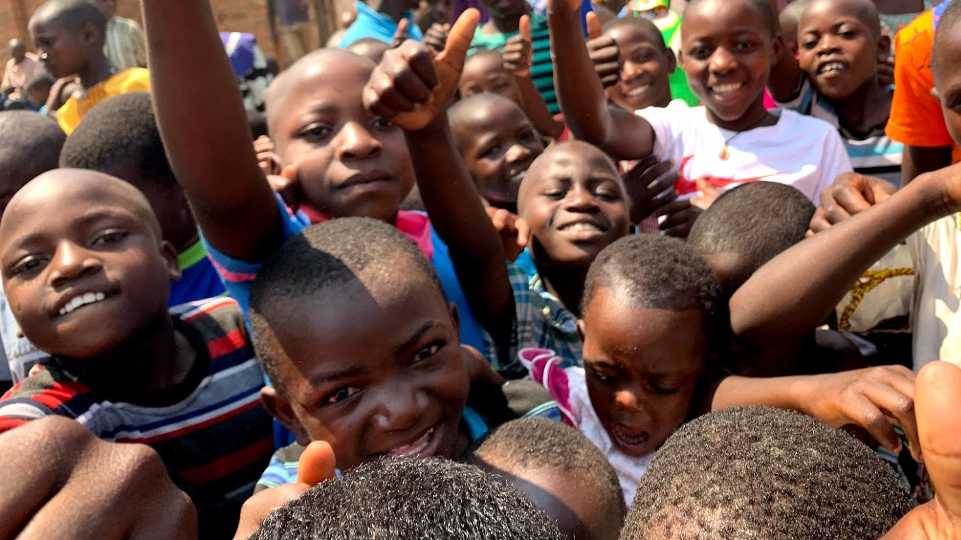
UGANDA
Proverbs 11:25
“A generous person will prosper; whoever refreshes others will be refreshed.”

Slide 2
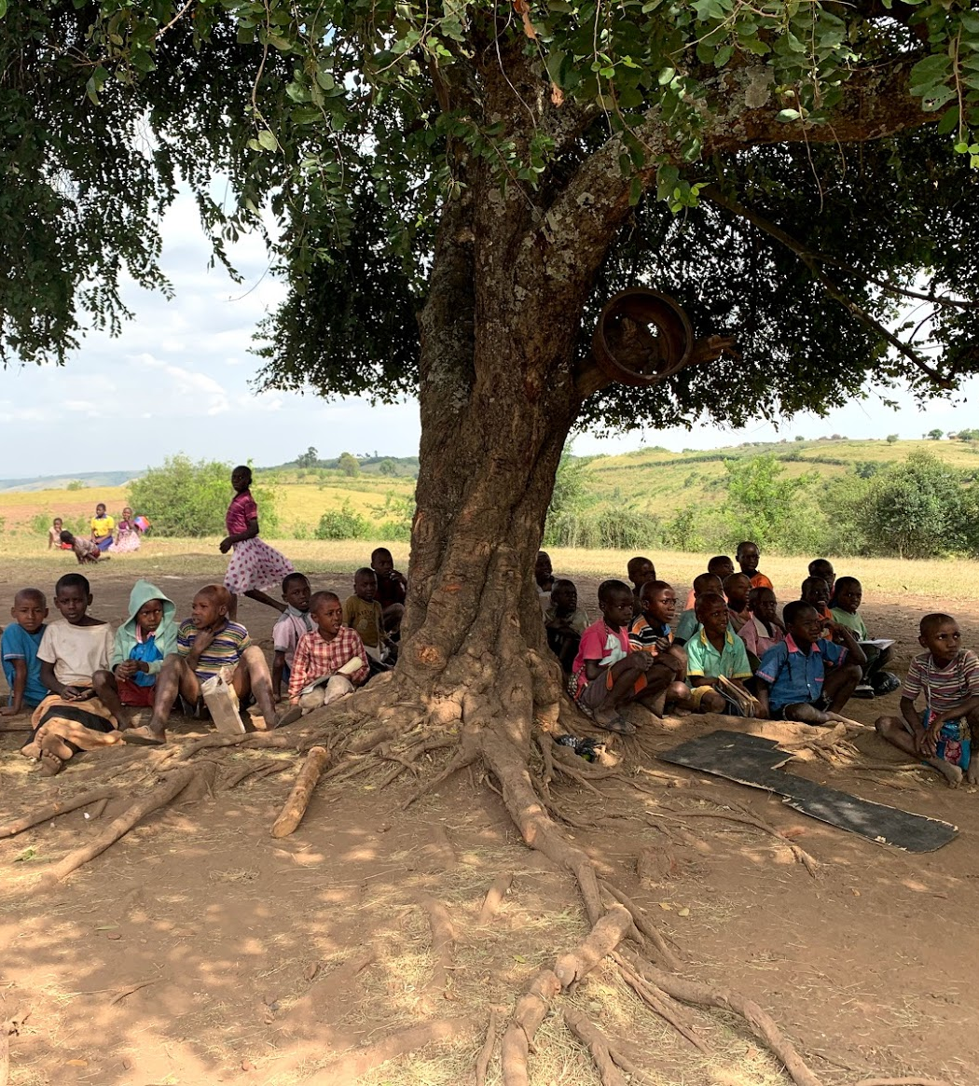
UGANDA
Undo the hunger
Give so they may grow
Always remember them
Never forget your blessings
Do as Christ, live fully
Act justly
Notes:
I created this Acrostic poem that embeds all that we can do to ensure justice for all.

Slide 3
LIVE FULLY ACT JUSTLY
OUR COLLEGE PILLARS:
Prayer, Learning, Compassion, Stewardship
We need to work together to live out our Motto. This can be done through understanding our Pillars

Slide 4
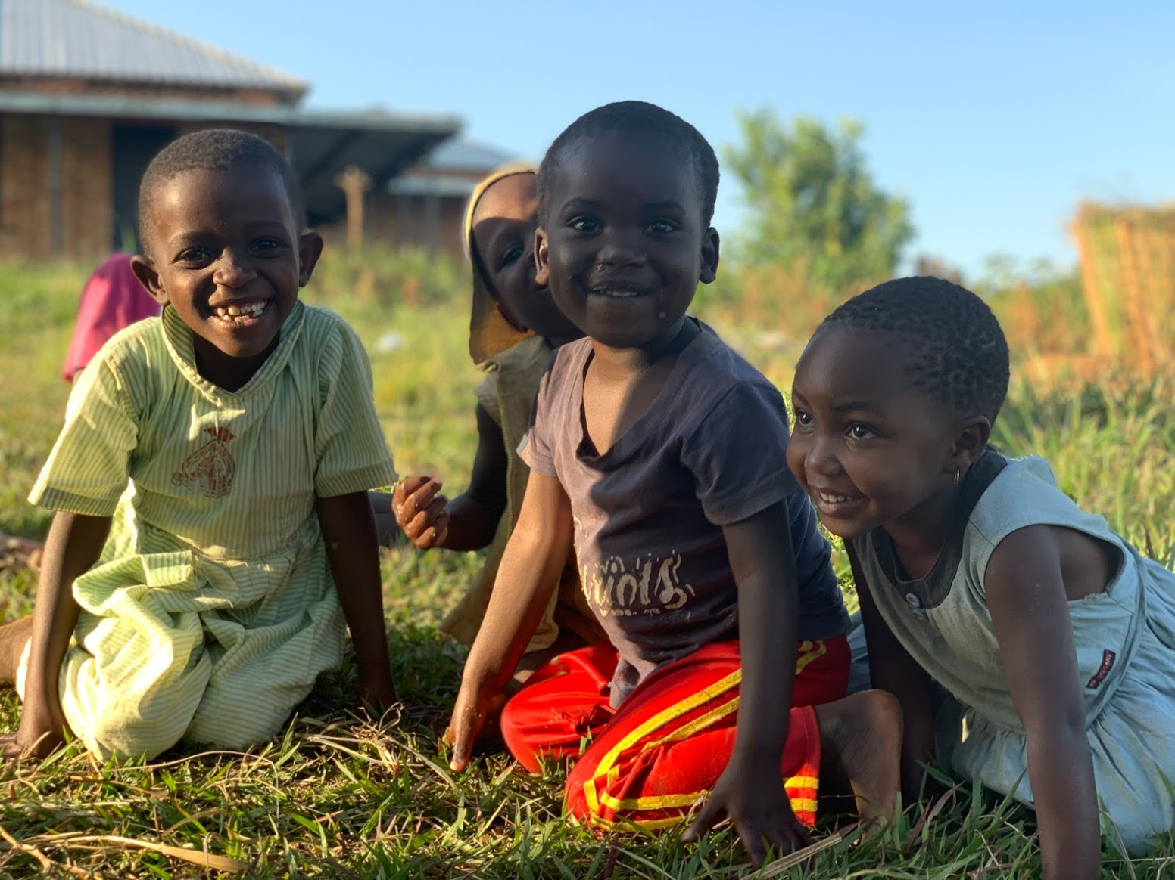
PRAYER Through prayer we can achieve the impossible. Each one of us can make a difference no matter how big or small…every prayer and good intention counts
God, you have given all peoples a common origin.
It is your will that they be gathered together as one family in yourself.
Fill the hearts of humankind with the fire of your love and with the desire to ensure justice for all.
By sharing the good things you give us, may we secure an equality for all our brothers and sisters throughout the world.
May there be an end to division, strife, and war.
May there be a dawning of a truly human society built on love and peace.
We ask this in your name.
Amen

Slide 5
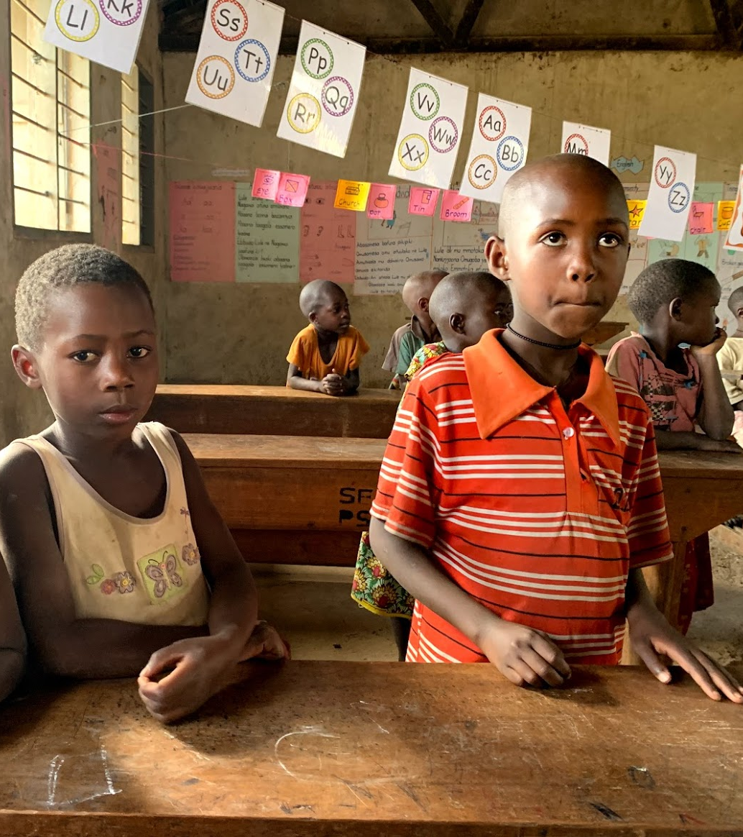
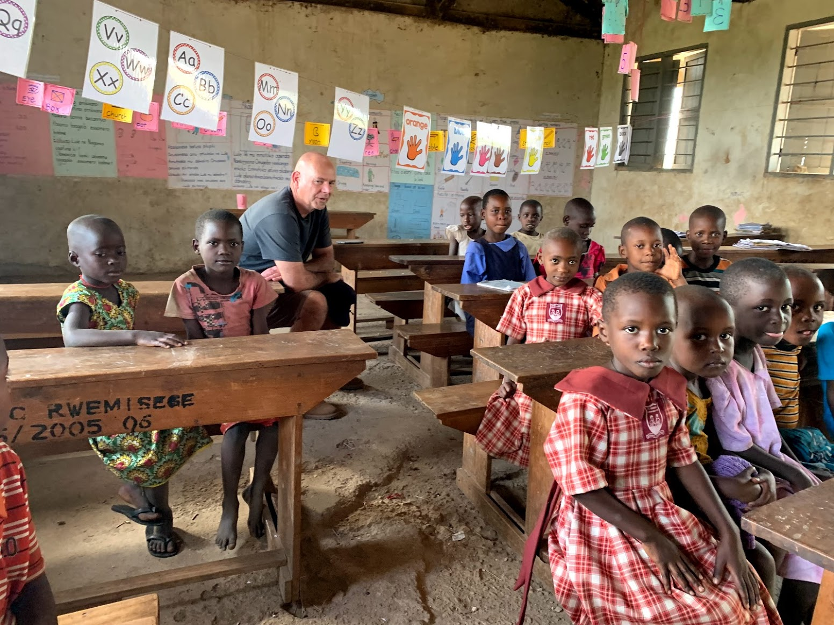
LEARNING As part of the learning, we need to recognize a need and act upon it as St. Mary Mackillop states, never see a need without doing anything about it.

Slide 6
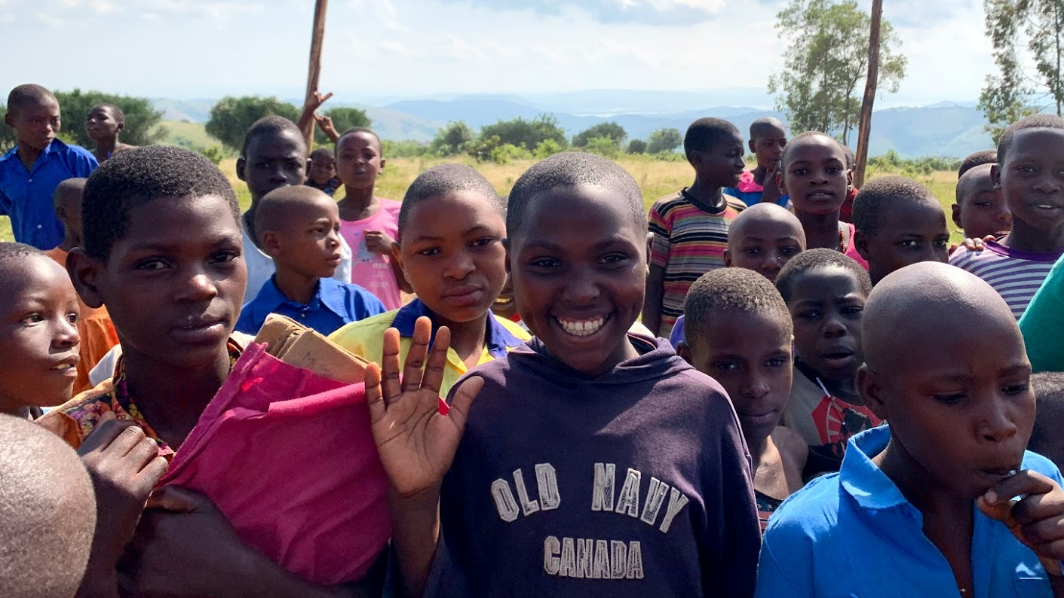
COMPASSION Together we can watch our community grow in compassion. Bringing out the smiles and working on leaving them their

Slide 7
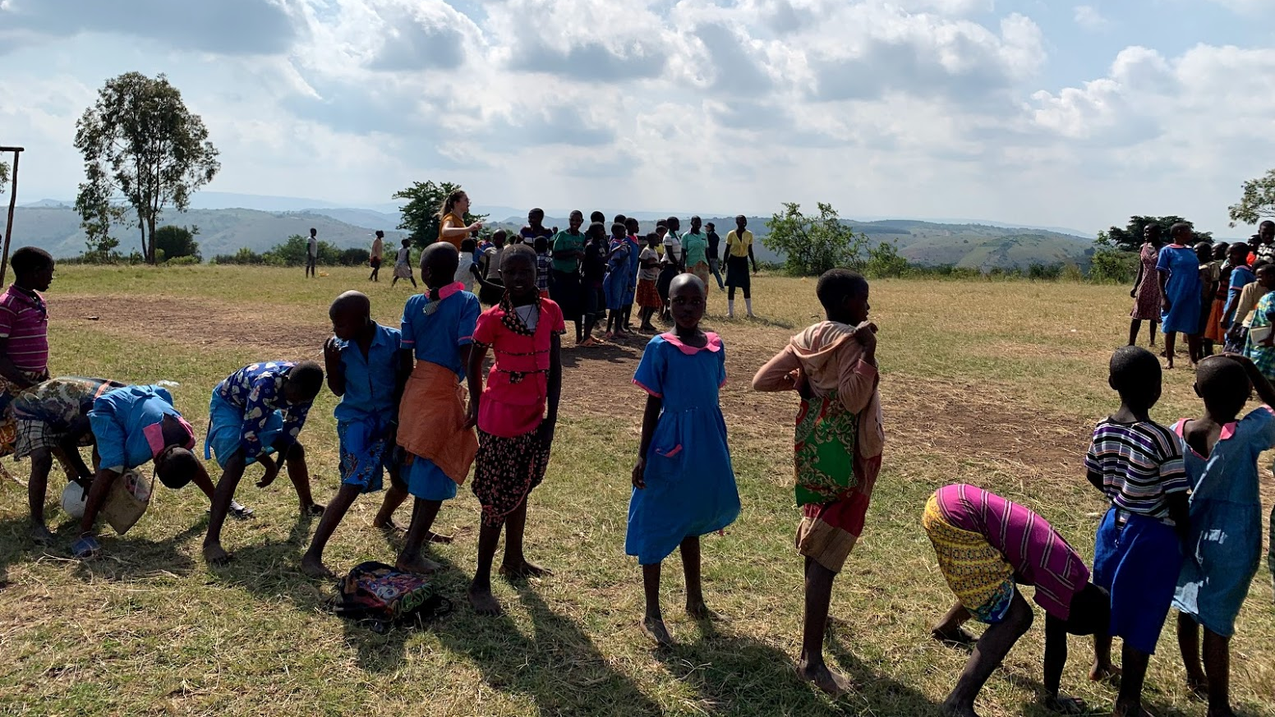
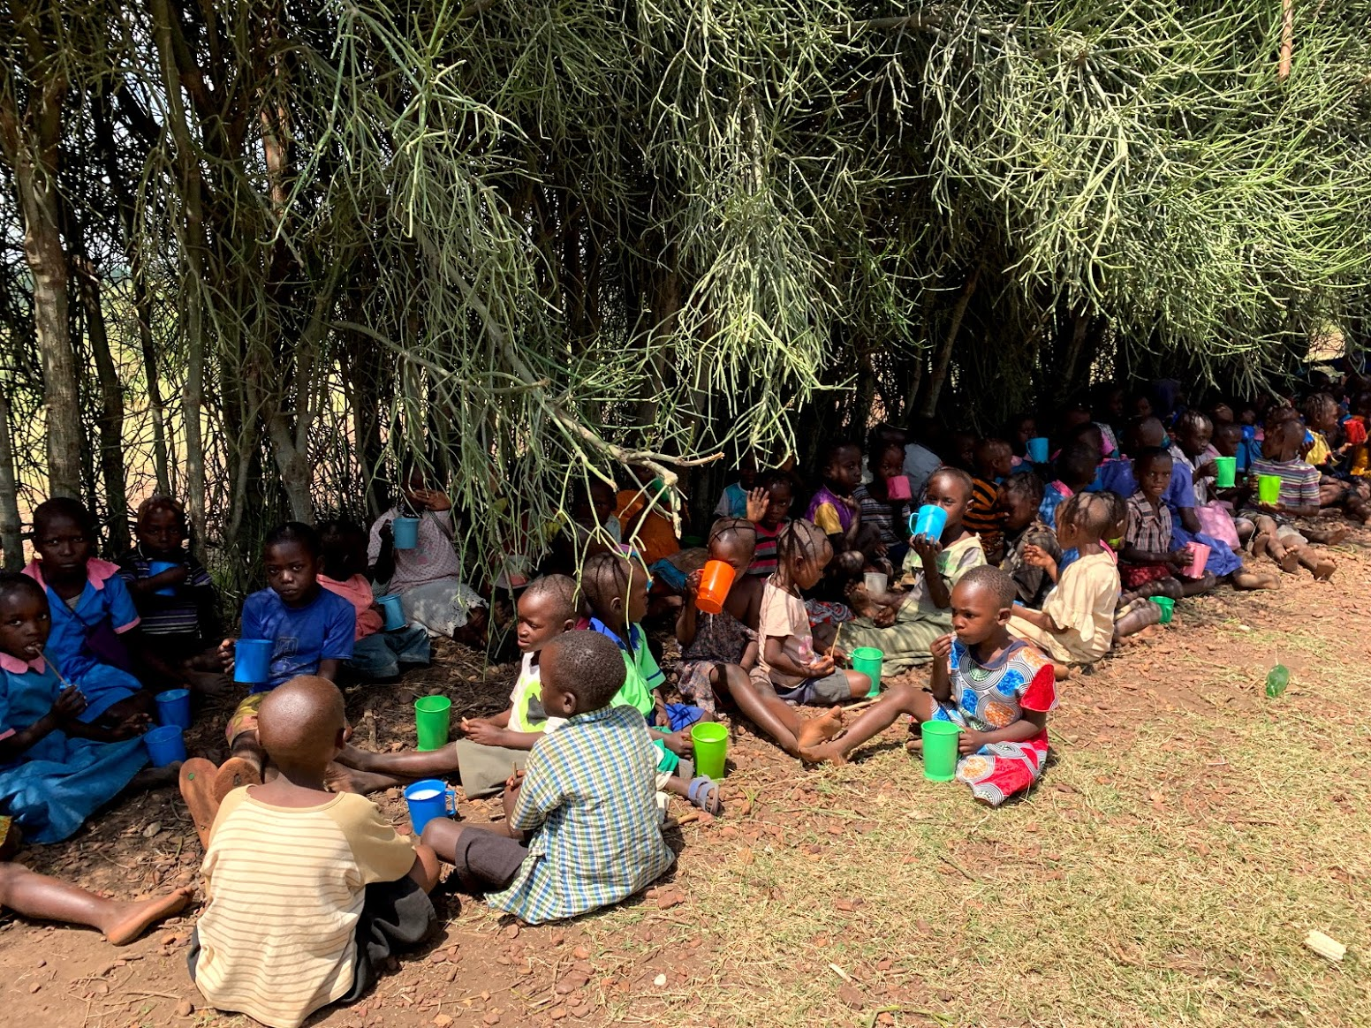
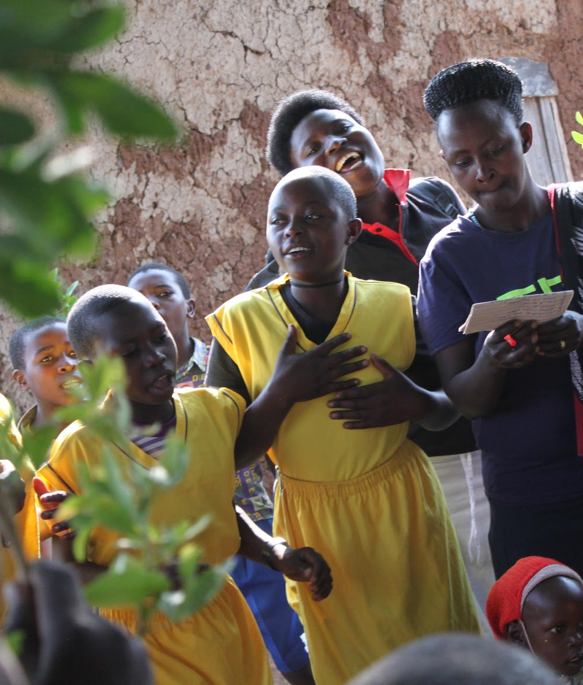
STEWARDSHIP Taking care of our world, the people, the place, taking on some responsibility, so that we can make a difference where it counts and where it matters. We need to recognize the gifts God has given us and share them gifts with others in our communities near and far.

Slide 8
We will be asking that each family donates $20.00.
Twenty Dollar Donation ($20.00)

Slide 9
TOGETHER WE CAN DO THIS!
Notes:
We can do this… remembering we are guided and guarded always

