Slide 1

Smiling mind
By Mia

Slide 2

Where did smiling mind originate ?
Smiling Mind was originated in Australia in 2012, with a goal of getting the technique of mindfulness meditation in an easy way.
The aim is also to get to as many people as possible to help relieve stress and anxiety and many other problems, to make the world a happier and less negative place.
Smiling mind is for everyone – we want to improve everyone’s mental health. To be positive and happy.

Slide 3
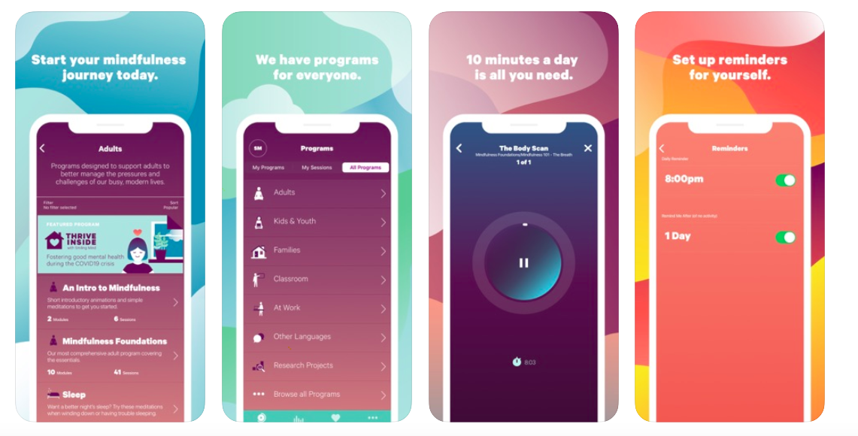
Health benefits of smiling mind
Some health benefits of smiling mind are relieving stress, anxiety, negative thoughts, depression making a clear mind, steady breathing, less stress on the heart and to prevent you from developing them and so many more.
For all of them there are techniques, like for stress there are breathing techniques that helps you to calm down and slow your breathing.
For anxiety there could be one for calming the mind and even if your stressed, anxious or scared before bed there's sleeping ones to, that make you calm and get a good night's sleep.

Slide 4
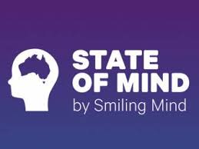
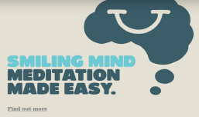
3 real life examples of when a young person may need to use smiling mind
When a child has a test and it’s the night before and thier stressed, they can use smiling mind and use a breathing technique.
When a child hasn’t completed the homework and its due that day, they can use calming technique that helps calm the mind.
When a child can't sleep, they can use a sleeping technique and it can help them sleep not stressed and calm.

Slide 5
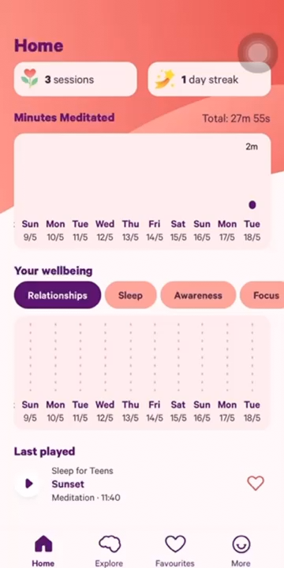
Step by step examples demonstrating how to use it
First find a quiet calm place where you can relax and get comfortable.
next open the smiling mind app and pick your smiling mind strategy to help what ever you are going through then start the session and begin.
Listen to the person speaking during the meditation, trying to focus your attention, avoiding other distractions as much as possible.
once you are done with your session you should feel calm and relieved.
You will have a smile on your mind! No negative thoughts!

